Slide 1
HAMLET
THE AUTHOR: WILLIAM SHAKESPEARE
LIFE
- William Shakespeare was born in Stratford-upon-Avon, in Warwickshire, traditionally on 23 April, which is Saint George’s Day, the patron saint of England;
- he got married in 1582 with Anne Hathaway and had a son and twins. We don’t know what job he did during this period. Perhaps he was involved in his father’s business (farming, butchering, wool-dealing and glove-making) or worked as a schoolmaster;
- then he moved to London, but we are not sure when he did. We think in 1585. He surely was in London in 1592 when he became a dramatist actor;
- when all the theatres closed because of the plague (1593) he stopped acting, wrote two long poems and strengthened his relationship with the Lord Chamberlain’s Company, during Elizabeth I’s reign and the King’s Men after the accession of James I in 1603;
- he became richer and richer: bought a new house in Stratford (1597), became part owner of the Globe Theatre (1599) and Blackfriars Theatre (1609);
- he retired in 1611, but he didn’t break all his business contacts with London and died on 23 April 1616 at the age of fifty-two.

Slide 2
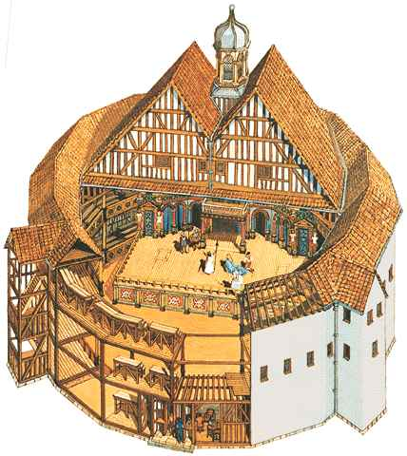
HISTORICAL CONTEXT
After the One Hundred Years’ War England became a stable kingdom through the War of the Two Roses (Lancaster against York). The war lasted thirty years (1455-1485) and at the end Henry Tudor became king with the name Henry VII. In 1509 he was succeeded by his son Henry VIII. This new king led a long fight with the Pope who didn’t let him divorce. The new King Edward was only nine years old when he began to rule (1547), but he died only six years later (1553). During the reign of Henry VIII England became a Protestant kingdom, but Catholicism was restored by Edward’s half-sister Mary. Then Elizabeth began to rule and Protestantism was again the English religion. Under Elizabeth’s reign England became a rich and powerful kingdom and drama developed thanks to many comedy or tragedy writers like William Shakespeare, Thomas Kyd, Robert Greene and Thomas Nashe. Shakespeare performed his plays mainly in London in the Globe Theatre.

Slide 3
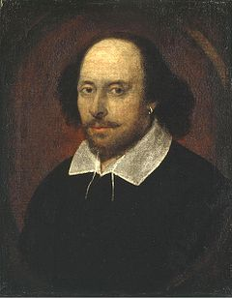
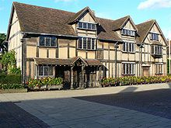
INTRODUCTION TO THE PLAY
COMPOSITION OF “HAMLET”
The real title of “Hamlet” was “The Tragical History of Hamlet, Prince of Denmark”. It was written by Shakespeare in 1601, was registered on 26 July 1602 and a complete version was published in 1603. Shakespeare based his “Hamlet” on another play with the same name that doesn’t exist anymore nowadays. This story was based on “Amleth”, by Saxo Grammaticus, a Danish historian (XII-XIII centuries). This story was very similar to Hamlet’s.

Slide 4
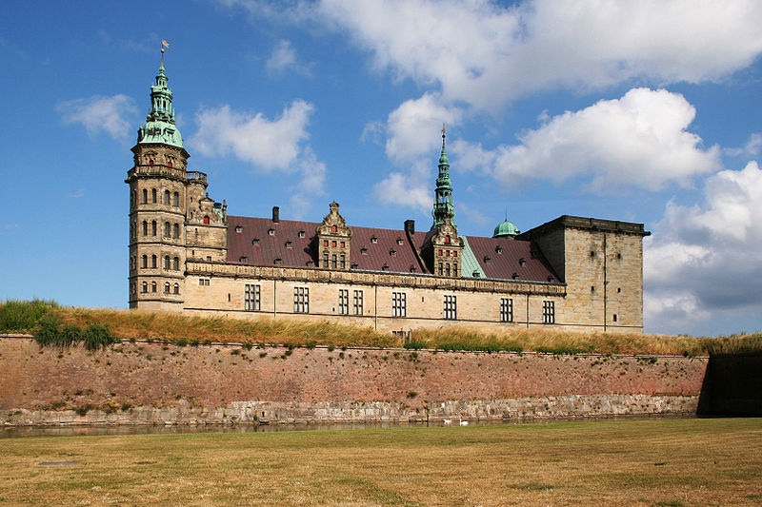
SETTING
The whole story is set in Elsinor Castle (Denmark), apart for some moments: for example, the lake where Ophelia drowned herself, the ship in which is Hamlet when he is going to England and the graveyard at the end of the play.
We don’t know exactly the time covered by the story. Between the first and the second act some months seem to pass. Then Hamlet goes to England and comes back. At that time voyages were very long. We can say the story lasts about half a year.

Slide 5
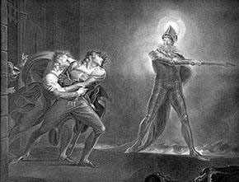
PLOT
FIRST ACT
Bernardo, Marcellus and Horatio, three sentries, see the Ghost of Hamlet, the late King of Danes and decide to call Prince Hamlet, King Hamlet’s son, the following night. Meanwhile, the new King Claudius is telling the court he has married Gertrude, King Hamlet’s wife. Finally he lets Laertes, Chamberlain Polonius’ son, return to Paris. The following day he leaves and urges his sister Ophelia to stay away from Hamlet, who is in love with her. Polonius blesses Laertes and tells the same to Ophelia. At night Prince Hamlet speaks to his father’s ghost and discovers the King was killed by Claudius and can’t find peace. He wants Hamlet to avenge him and kill Claudius.

Slide 6
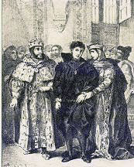
SECOND ACT
Claudius’ kingdom is in danger because it could be attacked by Fortinbras, Prince of Norway. Claudius sends some ambassadors and they come back telling Fortinbras won’t attack Denmark. He just wants to cross Denmark to get to Poland. Meanwhile Hamlet pretends to be mad to hide his real intentions. Polonius thinks Hamlet’s behaviour is due to unrequited love by Ophelia. The King and the Queen are not convinced, but they decide to send Rosencrantz and Guildestern, two friends of Hamlet’s, to discover the truth. Hamlet understands they are sent by the King and doesn’t tell them anything. Finally he discovers that a group of actors is coming to perform in Helsinore and decides to make the actors put on a particular play to know if Claudius has really killed his father.

Slide 7
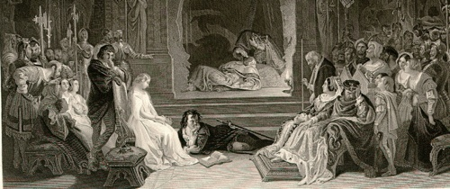
THIRD ACT
Ophelia begins to return Hamlet’s love, but she is treated very badly by the Prince. So Claudius and Polonius understand the cause of Hamlet’s madness is not love. Then Hamlet prepares the actors’ play. They must put on a play which shows a King murdered by his own brother and then the murderer marries the Queen. It’s what happened in Hamlet’s family. Claudius interrupts the play and is very upset. Now Hamlet is sure his uncle has killed his father. Finally Hamlet is called by his mother and tells her about her first husband’s murder. He treats his mother badly and she cries for help. Polonius, who is hidden and is listening to them, reveals himself to help the Queen, but he is killed by Hamlet who thinks he is his uncle. The Ghost appears, but only to Hamlet and reminds him his duty.

Slide 8
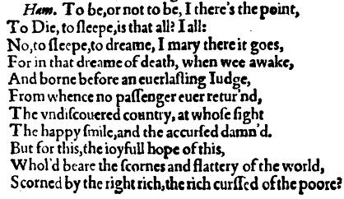
“TO BE OR NOT TO BE”
The famous sentence: “To be or not to be?” shows Hamlet’s interior feelings. He doesn’t know what to do: avenge his father’s death immediately or wait and, at the end, do nothing. So the real question is: “Live or die?”. If he lives he must kill Claudius and if he dies he can’t do his horrible duty.

Slide 9
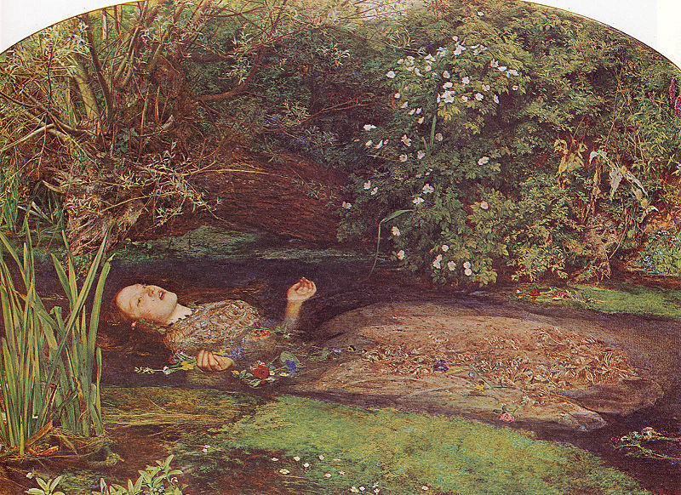
FOURTH ACT
Claudius understands Hamlet wants to kill him and decides to send his nephew to England with Rosencrantz and Guildenstern to have him killed by the English King. Besides, Hamlet doesn’t reveal where he has put Polonius’ corpse and Ophelia has become mad for her father’s death. Then Hamlet leaves for England, but his ship is attacked by pirates and he is taken prisoner. So he promises a good reward to them if they bring him back home and writes a letter to let Horatio and the court know he will come back the following day. Meanwhile, Laertes has come back from France. He blames Claudius for his father’s death, but the King explains what has happened and proposes Laertes to have a duel with Hamlet. Laertes agrees and says he will poison his sword to be sure Hamlet will die, while Claudius will poison the wine Hamlet will drink. Finally Gertrude comes up and says Ophelia has drowned herself. Laertes is now even more furious.

Slide 10
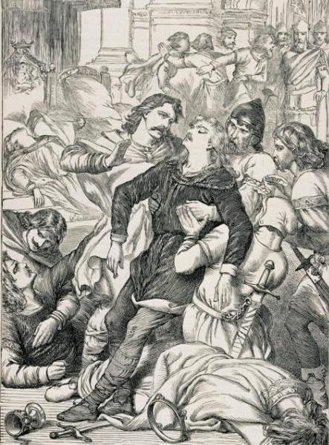
FIFTH ACT
Hamlet meets Horatio in a graveyard where two gravediggers are preparing Ophelia’s grave. He says that during his travel he has discovered he would be killed as soon as he had arrived in England. So he substitutes his name with the ones of Rosencrants and Guildenstern on another letter similar to the one written by Claudius. The mourners of Ophelia’s funeral come up and Hamlet reveals himself. Laertes tries to kill him, but the two are divided and they fence later. During the duel, Hamlet and Laertes exchange their swords and they are both poisoned. Gertrude drinks the poisoned wine and dies almost immediately. Laertes tells Hamlet the truth and they understand the cause of all the violence is Claudius. Finally Laertes dies, Hamlet kills Claudius with the poisoned sword and the poisoned wine. Horatio wants to poison himself to die with Hamlet, but the Prince convinces him not to do it. Horatio has to tell the world the whole story. Fortinbras comes up and Hamlet decides to give him his kingdom.

Slide 11
ANALYSIS OF THE PLAY
THEMES OF THE PLAY
Since Hamlet is a long and complex play, we can find many different themes in it. The play is five acts long, like most of the plays of the Elizabethan age. It consists of twenty scenes and their high number is consistent with the complex development of the characters and the long time covered by the actions. The division in scenes also gives the impression of the passing of time. The main themes of the story are:
- revenge;
- faithlessness, love and ambition which are intimately linked because we can find two or all of them in the same character;
- madness;
- role of the ghost;
- the murder of a king.

Slide 12
REVENGE
The theme which pervades the whole story is revenge. We have three different characters who want revenge:
Fortinbras wants revenge because Hamlet’s father has defeated his father in a duel. So he wants to defeat the Danes in battle;
Laertes wants revenge for his father’s death and for his sister’s madness. Hamlet is guilty of both. Laertes’ feeling of revenge could be honourable, but he is wrong because he allows himself to get involved in a dishonest duel;
Hamlet wants revenge to punish his father’s murderer who has also married his mother. Like Fortinbras and Laertes he has lost a father, but he feels he can’t act unless he is completely sure Claudius has murdered his father. His scruples make him lose time and this is also expressed in a monologue of criticism:
“... This is most brave,
That I, the son of a dear father murdered,
Prompted to my revenge by heaven and hell...”

Slide 13
FAITHLESSNESS, LOVE AND AMBITION
We find these three different themes in many characters:
Claudius murders his brother because he wants the throne (ambition), the Queen (love) and he is faithless towards his brother. He presents all the three themes;
Gertrude is faithless towards King Hamlet because she loves Claudius and marries him less than two months after her husband’s death ;
Ophelia loves Hamlet but she allows herself to be used by Polonius to discover what the cause of hamlet’s madness is. So she is faithless;
Rosencrantz and Guildenstern use their friendship with Hamlet (it’s a sort of “love”) to discover the cause of Hamlet’s madness (faithlessness);
the only character who is loyal to Hamlet is Horatio. He is friend to Hamlet (it’s a sort of love), he has great honour (the opposite of ambition) and is faithful (the opposite of faithless). It’s for hi good qualities that Hamlet chooses him to explain Fortinbras what has happened in Helsinor and to tell the world the whole story.

Slide 14
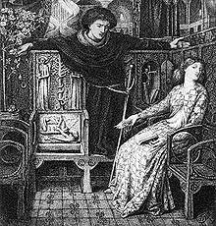
MADNESS
Only two characters show madness:
Hamlet, but he pretends to be mad and he is in contrast with Ophelia;
Ophelia has a real madness. We discover that the two characters show their real feelings and thoughts only when they aren’t rational. In fact Hamlet makes fun of chamberlain Polonius only when he is mad.

Slide 15
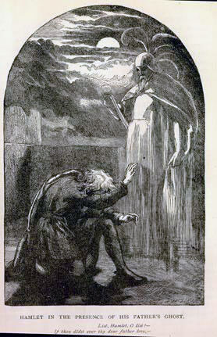
THE ROLE OF THE GHOST
The Ghost is very important. We can say better it isn’t a theme, it’s an aspect typical of the Elizabethan time. Perhaps we can’t understand very well his role because it’s more comprehensible if we think of the two different views of spirits and ghosts of that time:
traditional Catholic teaching: a man who dies without receiving forgiveness of his most serious sins is sent to hell; if he doesn’t receive forgiveness for his less serious sins he is sent to Purgatory where his soul suffers for a time; if he receives forgiveness for all his sins he is sent to heaven. We can see the ghost comes from Purgatory when it tells Hamlet:
“I am thy father spirit,
Doomed for a certain time to walk the night,
And for the day confined to fast in fires
Till the foul crimes done in my days of nature
Are burnt and purged away.”
Protestant view: the Devil sent ghosts to lure a man’s soul to hell. Hamlet worries that his father’s ghost could not be really him. This is evident when he says:
“The spirit that I have seen
May be the Devil. And the devil hath power
T’assume a pleasing shape; yea and perhaps
Out of my weakness and my melancholy,
Abuses me to damn me.”

Slide 16
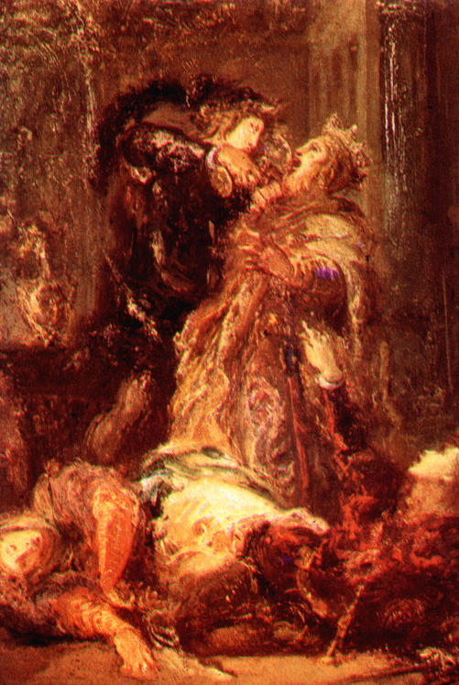
THE MURDER OF A KING
The role of the Ghost is also important because he tells Hamlet to kill a king. It means Hamlet must kill a person whose power has been given by God. If a country has a good king or a bad king, it means it deserves and needs it. The king has a Divine Right. So the Ghost is asking Hamlet not to kill just any murderer, but to kill an anointed king.

Slide 17
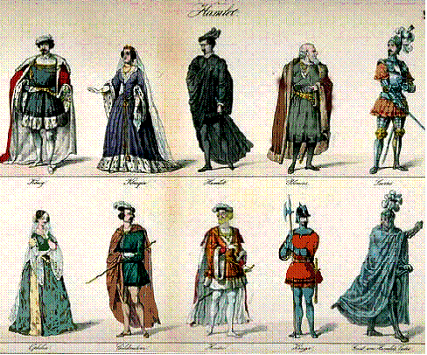
CHARACTERS
The characters of the story are:
- Prince Hamlet;
- King Claudius;
- Queen Gertrude;
- Ophelia;
- Chamberlain Polonius;
- Laertes;
- Horatio;
- Prince Fortinbras;
- Rosencrants and Guildenstern.

Slide 18
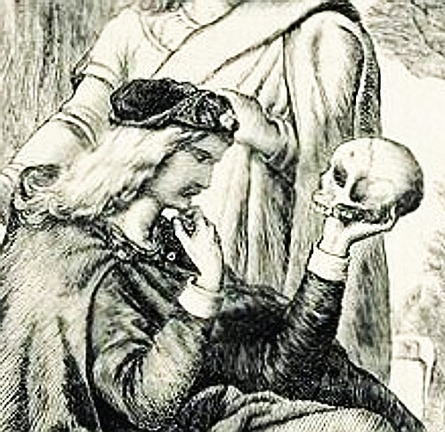
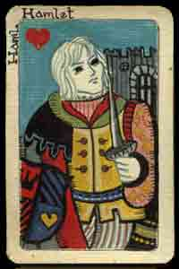
PRINCE HAMLET
Since Hamlet is the most important character, he is also the most complex. He is at the same time gentle and kind, loving and vindictive, a deeply reflective introvert and a man capable of acting on impulse. But all his good qualities, like Ophelia says, are cancelled by his madness, which is perhaps the most difficult point to understand. Then Hamlet is a very good judge because he can immediately understand that Ophelia, Rosencrantz and Guildenstern are sent by Claudius and Polonius. He is also courageous and loved by the Danes because he is the son of a wise king. At the beginning he is depressed and disillusioned for his father ‘s death and his mother’s marriage, but, when he knows that Claudius has killed his father this feelings turn to fury and he wants to take revenge. He is a round character and develops through the whole story.

Slide 19
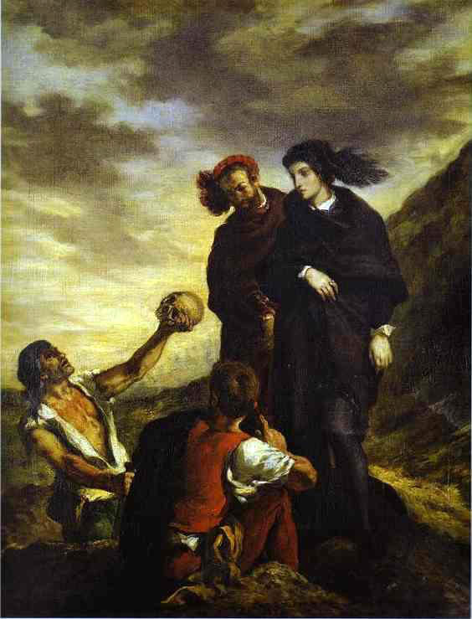
HAMLET’S AGE AND MADNESS
How old is Hamlet?
Is Hamlet really mad?
We don’t know his exactly age. We can say that at the beginning Hamlet is a man of thirty with a young mind, but at the end his mind is older because the events happened to him has made him grown.
There are three possibilities about Hamlet’s madness:
- he only pretends to be mad;
- at the beginning he isn’t mad, but then he goes mad;
- he shows signs of madness or at least mental instability throughout the whole play
In many episodes we can see Hamlet doesn’t have a full control of his behaviour, fore example when he cruelly treats Ophelia, when he behaves almost hysterically in his mother’s bedroom and when he fights against Laertes in Ophelia’s grave. This can make us think that, he shows signs of mental instability throughout the whole play.

Slide 20
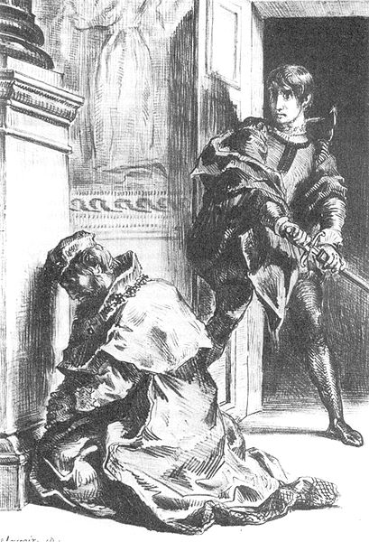
KING CLAUDIUS
Claudius is an evil character, but we can’t completely analyse him through Hamlet’s point of view, because also Claudius has some good qualities. According to, Claudius is much worse than King Hamlet. Anyway he is intelligent and perceptive because he immediately understands love isn’t the cause of Hamlet’madness and that his nephew could be a problem for his safety. He is also capable of thinking quickly and finding a good decision to save his life when he decides to send Hamlet to England. He is also diplomatic because he tries to make the court trust in him and he gets the promise that Prince Fortinbras won’t attack Denmark. Then Claudius is fond of his chamberlain Polonius and loves Gertrude.
On the other hand, he is evil because all his actions are done to save his life and to get more power. He is also able to manipulate Laertes so that he will kill Hamlet. Finally Claudius is really guilty because he is a murderer (of a king, who is God’s representative on earth) , an adulterer and is stained of incest.

Slide 21
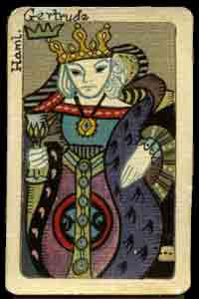
QUEEN GERTRUDE
Gertrude is a weak woman, but she isn’t evil. In fact the Ghost tells Hamlet he must kill Claudius, but he mustn’t punish Gertrude. She isn’t involved in her husband’s murder, because she doesn’t react badly in front of the “murderer play” organized by Hamlet. She is fond of Claudius, Polonius and Ophelia. She is sorry when the chamberlain and his daughter die. She also loves Hamlet and always supports him, even if she believes he is mad. In fact she’d like him to win against Laertes and she drinks a toast to his success, but she dies because the wine is poisoned.
Gertrude is also guilty of incest and faithlessness towards her old husband. Her Achilles’ heel is weakness, because she is easily manipulated by Polonius and Claudius who want to know the cause of Hamlet’s madness. But she isn’t stupid because, just like Claudius she understands the cause isn’t love, but it could be King Hamlet’s death and her sudden marriage with Claudius. In fact she says:
“His father death, and our o’erhasty Marriage”

Slide 22
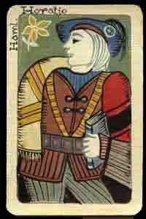
HORATIO
Horatio is the only character loyal to Hamlet. He is also honest, sincere, reliable and trustworthy throughout the whole play. So he is loved and admired by Hamlet. He is realist: when he first sees the Ghost, he doesn’t believe in it, but when he understands it is real he wants to do his duty: call and tell what has happened to Hamlet:
“Let us impart what we have seen tonight
Unto young Hamlet; for, upon my life,
This spirit, dumb to us, will speak to him.”
He always helps Hamlet and wants to die with him when the Prince is dying:
“I am more an antique Roman than a Dane.
Here’s yet some liquor left.”
But Hamlet wants him to tell the whole story to Fortinbras and to the world and Horatio accepts this task.

Slide 23
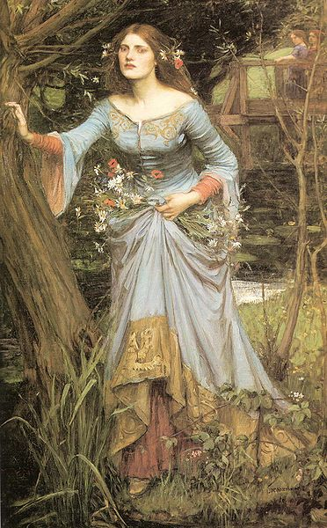
OPHELIA
Ophelia is a very particular character in the story: she is a young, beautiful and innocent girl and no character has anything evil to say to Ophelia. Then she has a parallel story with Hamlet: she has lost her father, can’t crown her love dream and dies before her time. She is lovely and she obeys to her father and her brother who don’t want her to love Hamlet. We can’t say this is weakness, because at that time parents had a great power on their children. Neither when she accepts to help Polonius and Claudius to discover the cause of Hamlet’s madness is weakness, because she’s really in love with Hamlet and this is an occasion to meet him. Finally Ophelia has another good quality: she is witty, for example when she tells her brother to be careful when he’s in France.
Ophelia’s only bad characteristic is that she isn’t strong enough to endure Hamlet’s love refusal and her father’ death. In fact she admires a lot both her father and Hamlet.

Slide 24
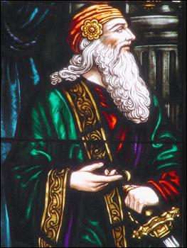
CHAMBERLAIN POLONIUS
Polonius is an old and wise man. Hamlet makes fun of him when he pretends to be mad and doesn’t have much respect for him. Anyway, Polonius isn’t stupid; he is respected by the whole court and he is a very important member in it. In fact he is Claudius’ chief counsellor, the chamberlain of the king. He’s only just a bit obtrusive and gossipy, but he is indispensable for the king and the court because old age has made him talkative and suspicious, two qualities useful to avoid and solve problems in a kingdom.

Slide 25
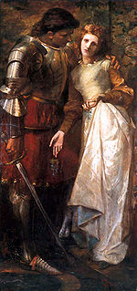
LAERTES
In the play Laertes is like a contrast to Hamlet. Like the Prince he is noble, loved by the Danes and his father has been murdered. He is impulsive and immediately wants his revenge. He is good at speaking and soon wins the support of the Danes against Claudius. He is ready to risk everything (even his life) to achieve his objective, like his revenge. He is really fond of his sister and doesn’t want her to listen to Hamlet’s love declarations too seriously. He always defends her and her goodness, for example at the funeral: when the priest doesn’t want to bury her in the graveyard because she has committed suicide.
Laertes is a bit weak because he can be easily manipulated. The king gets him to use a trick to kill Hamlet in a fencing duel. But at the end he understands the “villain” is just Claudius, he is repentant, asks Hamlet for forgiveness and forgives the Prince for his and his father’s death:
“Exchange forgiveness with me, noble Hamlet.
Mine and my father’s death come not upon thee.
Nor thine on me!”

Slide 26
PRINCE FORTINBRAS
Fortinbras is the Prince of Norway and, like Hamlet, he has lost his father and his kingdom is held by his uncle. Hamlet’s father has defeated his father in a duel and now Fortinbras wants to redeem his father’s name. So he decides to defeat the Danes, but then he is persuaded to march against the Poles. He is Hamlet’s model: he is a man of courage, action and honour. Hamlet is spurred to his revenge by the immediacy of Fortinbras’ actions. Also Fortinbras considers Hamlet a courageous and wise man:
“... He was likely, had he been put on,
To have proved most royally.”

Slide 27
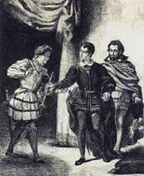
ROSENCRANTZ AND GUILDENSTERN
Just like Horatio, Rosencrantz and Guildenstern have known Hamlet since they were at university. They are two of Hamlet’s friends, as we can understand from the Prince’s greeting to them:
“My excellent good friends! How dost thou, Guildenstern! Ah, Rosencrantz! Good lads, how do ye both?”
Also the Queen knows them through Hamlet:
“Good gentlemen, he hath much talked of you;
And sure I am two men there are not living
To whom he more adheres.”
Rosencrants and Guildenstern are a stereotype: they are the kind of man who always serves his ruler without asking anything. In fact they allow themselves to be used by Claudius and to use their friendship with Hamlet against him (to discover the cause of Hamlet’s madness). But they are not evil: in fact we can’t be sure if they knew that they were taking Hamlet to his death in their travel to England.

Slide 28
CONCLUDING REMARKS ON “HAMLET”
“Hamlet” is one of the most popular of Shakespeare’s plays. In this play, Shakespeare gives a wonderful description of human types and feelings. But the characters are never exaggerated: we can understand the motives of the evil characters and the ideals of the good ones.
The author has also put an element of mystery around each character and the whole story. We can’t know if Hamlet was really mad, Claudius was really evil or suffered remorse for his action, Gertrude really loved Hamlet and, if so, how she could marry again with Claudius. Every character is a real living person with his mind, problems and feelings. We can only say that “The Tragical History of Hamlet, Prince of Denmark” is one of Shakespeare’s masterpieces that will continue to impress audiences with its understanding knowledge of humanity, its beautiful language, its humour and its pathos.

